Slide 1
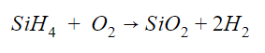
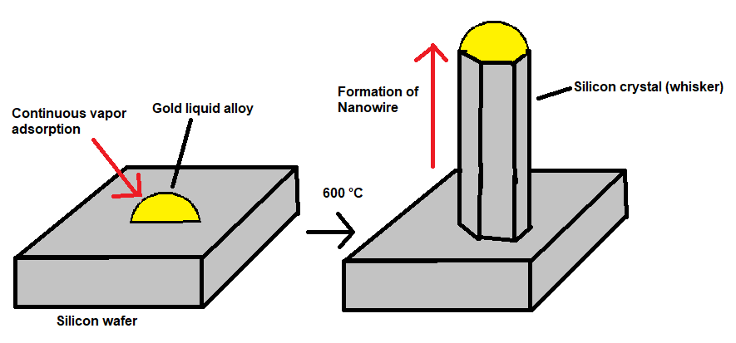
Silicon Nanowires
Brendan Kearney, Inorganic Chemistry
What are nanowires?
Synthesis
Chemical Properties
Nanowires are defined as any small repeating structure within the length of a nanometer.
These wires may be composed of metallic, organic, or inorganic units.
Inorganic nanowires can act as insulators, semiconductors, or superconductors depending on their molecular compositions.
They have many industrial applications, including in electrical devices, batteries, solar cells, and environmental detectors.
The primary mechanism used to synthesize SiNWs involves the formation of silicon lattice from silane (SiH₄) through a process called chemical vapor deposition, which uses extremely high heat to induce reactions of and deposit the solid product in a uniform fashion.
Due to the naturally slow rate of lattice formation using vaporization, Wagner (1964) proposed a mechanism, vapor-liquid-solid, which introduces a liquid catalyst to the nanowire synthesis process. This particle, usually made from gold or zinc, adsorbs most of the silicon vapor to the point of supersaturation, making the crystal structure (whisker) from the liquid alloy.
Lieber (1998) used laser ablation (a form of top-down manufacturing) to produce catalysts to be used for v-l-s synthesis. However, other methods, such as metal-assisted chemical etching (Huang, 2010) can be used.
The general mechanism involves the introduction of Au particle islands on silicon wafer through the use of lasers or electron-beam evaporation. Using a special chemical vapor deposition apparatus, the wafer is heated to 400-500 °C for about 1 hour. 5% SiH₄ is added in He is added under constant flow.
Synthesizing silicon nanowires is difficult due to the low efficiency of the silane to silicon atom reactions. Among all silane starting materials tested (Tuan, 2007), monophenylsilane was concluded to be the best for Au-Si nanowires. However, due to a still low yield of 1-5%, the solvents were also tested to see if they affected nanowire formation. A change from hexane to benzene and toluene dramatically increased the yield.
Semiconductor – contains many p-n junctions in nanowire lattice, increasing affinity for electric current while maintaining the direction of electron movement. In SiNWs, p-n junctions can be situation in a planar, vertical, or radial orientation.
Highly refractive – can be used in photonic devices due to strong resonant field enhancement of visible light (Brönstrup, 2010). Optical properties based on the diameter of
Low thermal conductivity – Although bulk silicon materials are considered good thermal conductors, silicon nanowires have a much lower thermal conductivity. Two reasons explaining this are the larger surface to volume ratio in nanowires and the effects of surface reconstruction (Ponomareva, 2007). This insulating effect is very beneficial for electrical devices for saving energy and reducing wear and tear.
Figure 3. Examples of each of the two synthetic techniques for nanowires: bottom-up² and top-down³
Figure 1. Silver Nanowires – 400 nm¹
History of Silicon Nanowires
One of the first reports mentioning nanowires was in 1991 by Japanese physicist Sumio Ijima, in the form of helical carbon microtubules. From there, the study of semiconducting nanowires, which include silicon nanowires (SiNWs), exploded within the next decade. The first method of silicon nanowire synthesis was presented in 1998 by Lieber, whose results with electrode testing demonstrated varied thermal conductivity behavior and sparked further interest in the composition of different semiconductor nanowires. Since then, other methods of synthesis for SiNWs have been published (Yu, 2000).
Further study of SiNWs include their potential as solar cells, where they have yet to achieve efficiency rivaling current commercial products. Another area of interest is the distinguishing of varying techniques used for nanowire synthesis, known informally as the top-down and bottom-up methods. In bottom-up production, nanowires are built from the aggregation individual molecules. Top-down utilizes the opposite approach, producing crystalline nanostructures from larger materials such as earth minerals.
Figure 5. Photovoltaic cell comprised of 36 individual arrays of silicon nanowires featuring radial p-n junctions⁴
Figure 4. Vapor-liquid-solid mechanism with Au-Si alloy.
Left: Au alloy added to silicon substrate, start of reaction
Right: progression of crystal formation after vaporization.
Applications
Efficient and inexpensive solar cells
Interfacing with living cells and biological processes– acting as microscopic waveguides in mammalian and neural cells
Lithium battery anodes (Chan, 2008) with higher charge capacity than conventional materials
Memory devices for computer storage
Bottom-up style
Top-down style
Image Credits
1 Cangzhou Nano-Channel Material Co.
2 McMurphy, K.. Two Ways to Make Nanoparticles, sustainable nano
3 Tulsky, E., Dimensional Reduction, Chem Mater.
4 Yang,P. Trapping Sunlight with Silicon Nanowires. http://newscenter.lbl.gov/2010/03/03/trapping-sunlight/
Figure 2. Examples of each of the two synthetic techniques for nanowires: bottom-up² and top-down³

